Slide 1
Tutorial M6932
Air Traffic Control
Submission Date: 25th Feb

Slide 2
Exercise 1: Airport Diagram

Slide 3
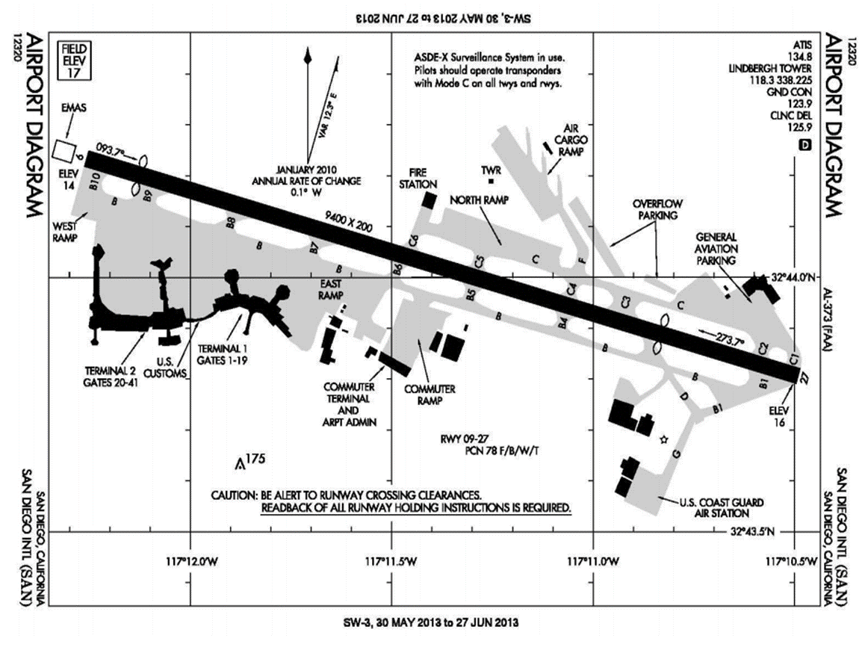
What is the name of Airport?
What is the Identifier for the Airport?
What period of time is this airport diagram valid?
How many Runway/s?
What are the Runway Names?
What is the Magnetic Heading of each Runway?
What is the difference between Magnetic Heading and True Heading at this airport?
How fast is Magnetic Heading changing at this airport?
Locate ATC Control Tower
What is Field Elevation for the Airport?
Runway 9 Characteristics
a. What is the Magnetic Heading?
b. What is the Touchdown Zone Elevation?
c. How long is the runway?
d. How wide is the runway?
Runway 27 Characteristics
a. What is the Magnetic Heading?
b. What is the Touchdown Zone Elevation?
c. How long is the runway?
d. How wide is the runway?
Any Runway Crossing Alerts?
Please answer these questions
You may refer to latest Airport Diagram of San Diego Intl Airport.

Slide 4
Exercise 2: EMAS Systems

Slide 5

EMAS Systems
La Guardia Airport (LGA) has installed EMAS systems on all the runway ends. Assume the critical aircraft operating at LGA and used in the EMAS installation is the Boeing 757-200 (pictured below).
Boeing 757-200

Slide 6
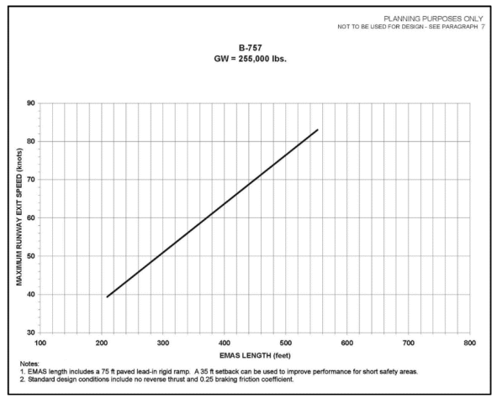
EMAS Length
a) Use Google Earth and estimate the length of the EMAS systems installed at runways ends 4 and 31.
b) Using the guidance of the Advisory Circular 150/5220-22A estimate the length of an EMAS installation to stop the critical aircraft at the design speed of 70 knots.
c) If the values estimated in parts (a) and (b) are not the same, estimate the maximum exit speed the EMAS systems at LGA would contain the critical aircraft. Explain.

Slide 7
Exercise 3: Declared Distances

Slide 8
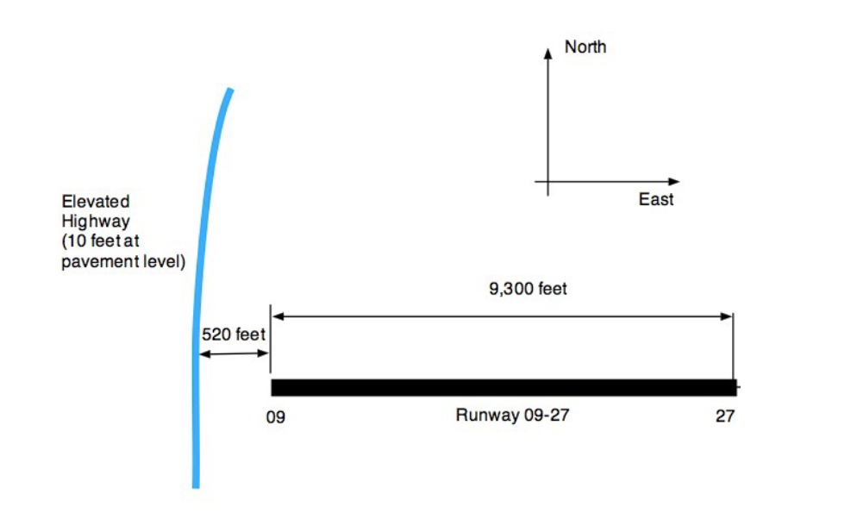
Runway Configuration for the Problem
a) Using the declared distance concept, find the Landing Distance Available (LDA) for aircraft landing
on runway 27. In your analysis provide Runway Safety Area (RSA) protection. There is no EMAS at this airport.
b) Find the Accelerate and Stop Distance Available (ASDA) while taking off on runway 27.

Slide 9
End of Tutorial

